Slide 1
Financials
Bike Industry

Slide 2
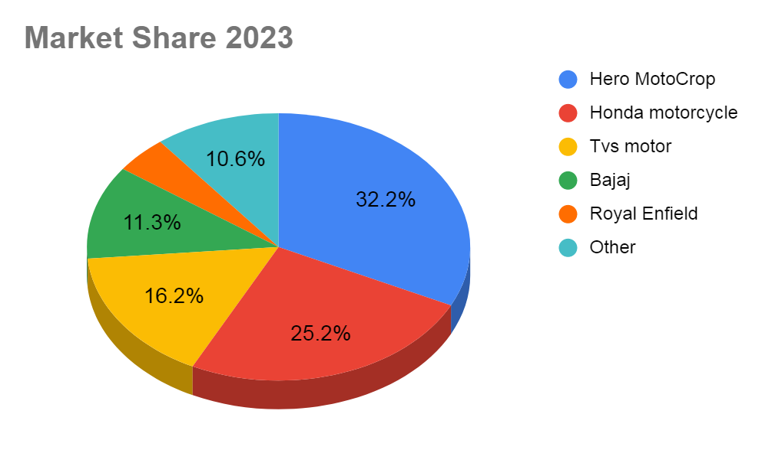

Slide 3
Market Share 2019 - 2023
Company | 2019 | 2020 | 2021 | 2022 | 2023 | Avg
Hero motors | 36.60% | 41.80% | 39.20% | 34.51% | 32.20% | 36.86%
Honda motorcycle | 26.31% | 19.80% | 20.50% | 24.83% | 25.20% | 23.33%
Tvs motor | 14.80% | 14.30% | 14.30% | 15.07% | 16.20% | 14.93%
Bajaj | 12.00% | 14.30% | 13.70% | 11.70% | 11.30% | 12.60%
Royal Enfield | 3.80% | 4.20% | 4.30% | 3.79% | 4.50% | 4.12%
Others | 6% | 6% | 8% | 10% | 11% | 8%
Out off | 100% | 100% | 100% | 100% | 100% | 100%
Total | 93.51% | 94.40% | 92.00% | 89.90% | 89.40% | 91.84%

Slide 4
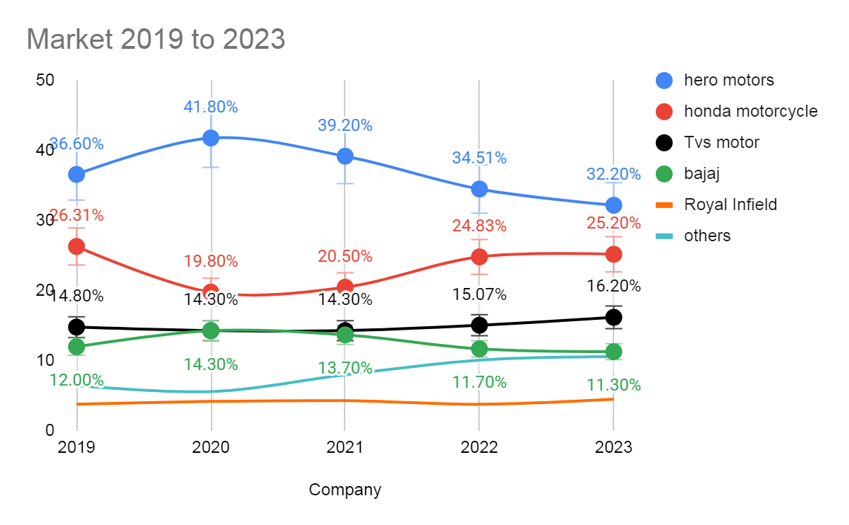

Slide 5
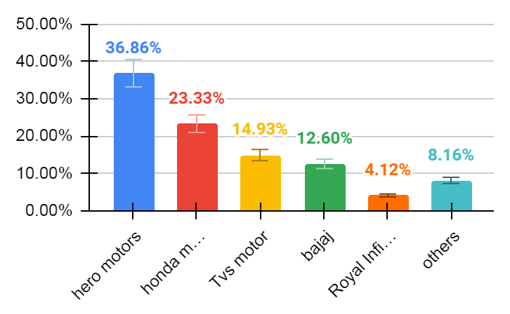
AVG. Market Share

Slide 6
Market Sales
Company | 2019 | 2020 | 2021 | 2022 | 2023 | Avg
hero motors | 6,670,388 | 5,388,331 | 5,599,859 | 5,756,900 | 386,184 | 4,760,332
honda motorcycle | 4,803,053 | 3,579,557 | 3,867,817 | 4,055,757 | 338,289 | 3,328,895
Tvs motor | 2,693,963 | 1,988,458 | 2,164,228 | 2,422,864 | 232,956 | 1,900,494
bajaj | 2,285,358 | 1,723,391 | 1,809,375 | 2,036,750 | 181,828 | 1,607,340
Royal Infield | 690,913 | 538,889 | 573,438 | 628,536 | 68,881 | 500,131

Slide 7
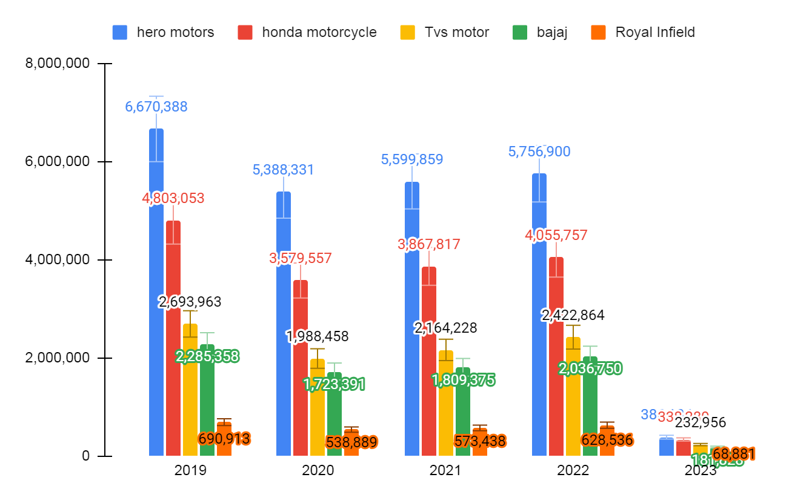

Slide 8
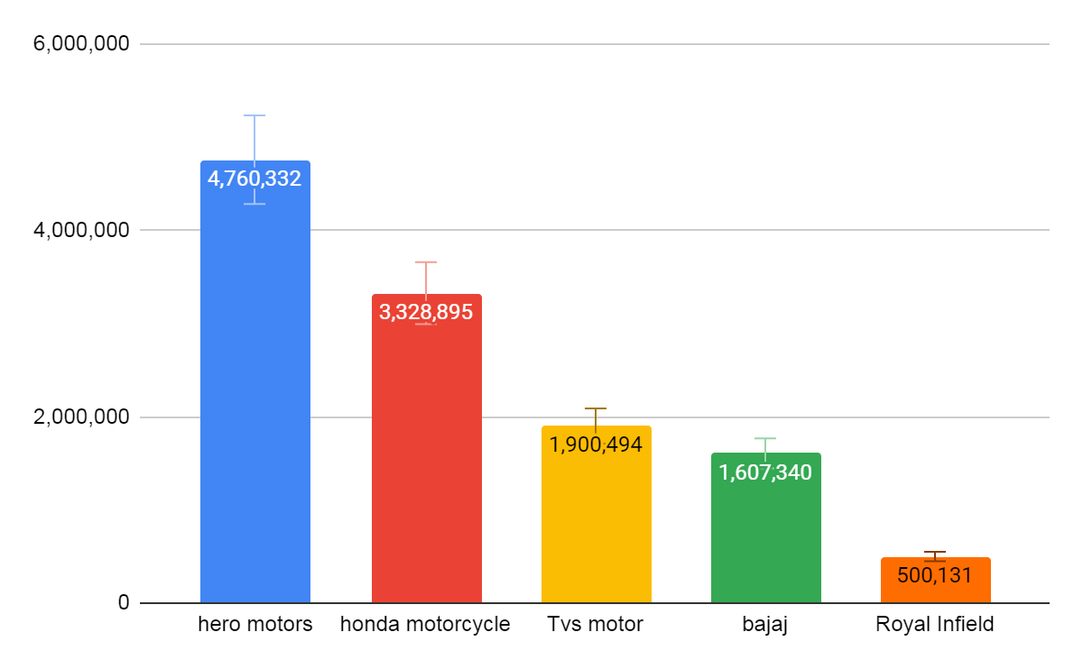

Slide 9
Net Profit in Cr.
Company | 2019 | 2020 | 2021 | 2022 | 2023 | AVG
hero motors | 3444.1 | 3636.1 | 2197.8 | 2316.9 | 2810 | 2880.98
honda motorcycle | 549.3 | 419.3 | 618 | 629.3 | 514.5 | 546.08
Tvs motor | 704.7 | 624.6 | 594.3 | 756.8 | 1328.7 | 801.82
bajaj | 4927.6 | 5211.9 | 4857 | 6165.9 | 6060.2 | 5444.52
Royal Enfield | 2202.7 | 1827.4 | 1346.9 | 1676.6 | 2913.9 | 1993.5

Slide 10
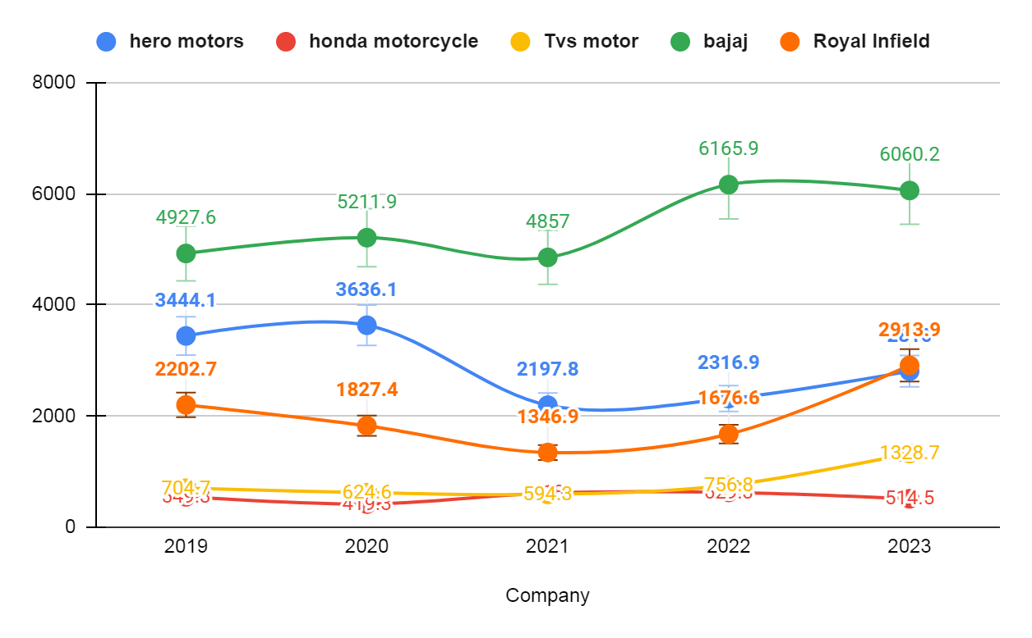

Slide 11
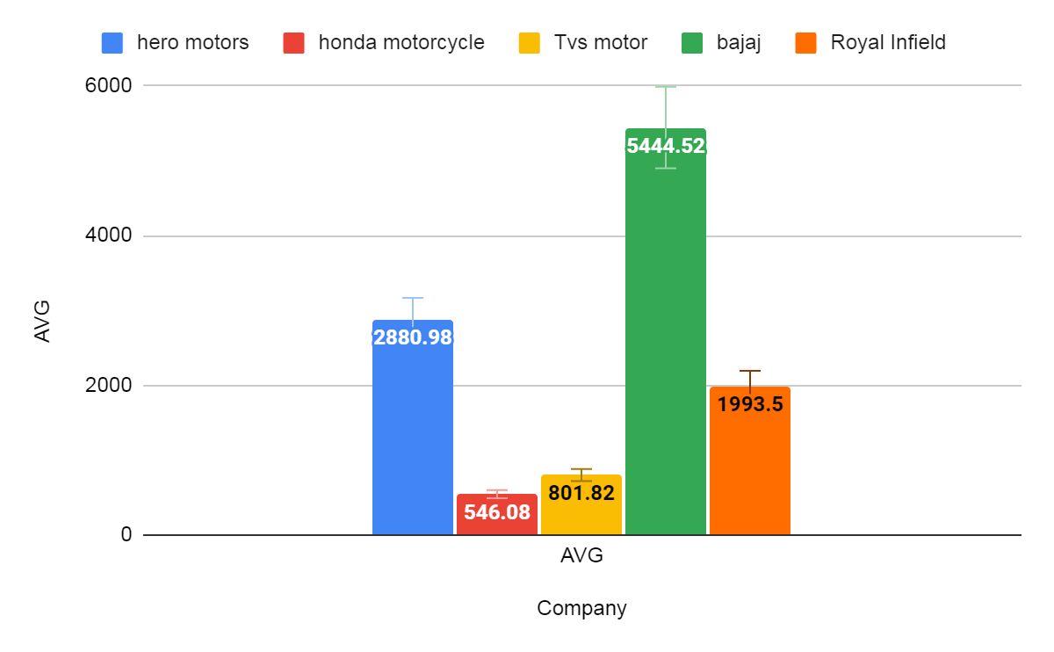

Slide 12
Revenue in Cr.
Company | 2019 | 2020 | 2021 | 2022 | 2023 | Avg
hero motors | 34657.6 | 29984.5 | 31517.1 | 30106.3 | 34727.4 | 32198.58
honda motorcycle | 14299.8 | 13736.5 | 12380.3 | 12951.9 | - | 13342.125
Tvs motor | 20185.4 | 18901.1 | 19468 | 24388.2 | 32112 | 23010.94
bajaj | 31702.1 | 31443.2 | 29017.5 | 34428.8 | 37642.9 | 32846.9
Royal Enfield | 10240.5 | 9696.8 | 9173.5 | 10738.6 | 15037.3 | 10977.34

Slide 13
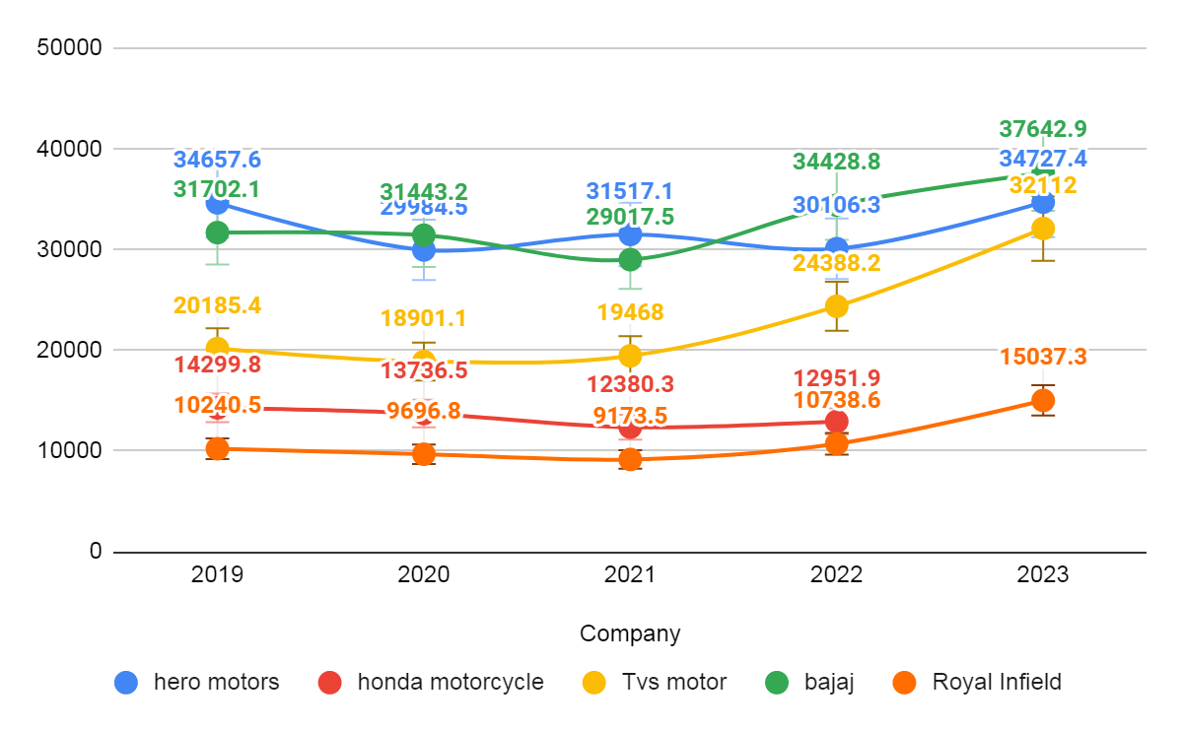

Slide 14
